Slide 1
Benchmarking University Support Units
Michelle D. Taylor | Senior Research Analyst | NHEBI
Dr. Frank W. Oakgrove | Institutional Planner | University of Wisconsin Stout

Slide 2
Benchmarking at the Unit Level
First-ever Higher Education Institution to receive the Malcolm Baldrige Award
Cost & Productivity Project
NCCBP
AAUP
University of Kentucky
University of Iowa
University of Wisconsin - Oshkosh
Northern Michigan University
Walden University
University of Rhode Island
Wichita State University
University of Wisconsin - Parkside
College of the Mainland
Dunwoody College of Technology
Southwestern Indian Polytechnic Institute
Baker University
Advisory Board
Notes:
At UW-Stout we have a long history of continuous improvement. In fact we are the first-ever Higher Education institution to receive the Malcolm Baldrige Award. IF you are not familiar, the award was established by the U.S. Congress in 1987 to raise awareness of quality management and recognize U.S. companies that have implemented successful quality management systems.
Since receiving the award in 2001, we have worked with educational institutions in 39 states and 25 countries, sharing information and assisting schools that are interested in quality improvement.
As assessment and evaluative practices move beyond just the classroom. We started to look for opportunities to benchmark at the unit level. Unfortunately in our research there was very little available at the unit level. In our research we found the work of the National Higher Education Benchmarking Institute. And I will turn it over to Michelle to share a bit about NHEBI.
We develop a tool that takes the guess work out of benchmarking. By developing standard metrics with underlaying institutional characteristics to get to apples to apples comparisons

Slide 3
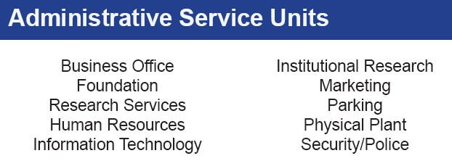
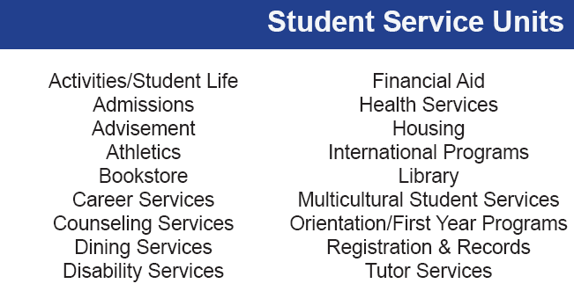
Benchmarking Project
Universitybenchmarking.org
Notes:
Here we discuss the development of UBP tapping Experts and a number of different institutions to develop metrics that are meaningful for all participants within the project
Advisory Board Members assisted with
selection of data elements
crafting of data definitions
reviewing the draft data collection protocol
reporting strategies
the implementation of a pilot test of the data collection process

Slide 4
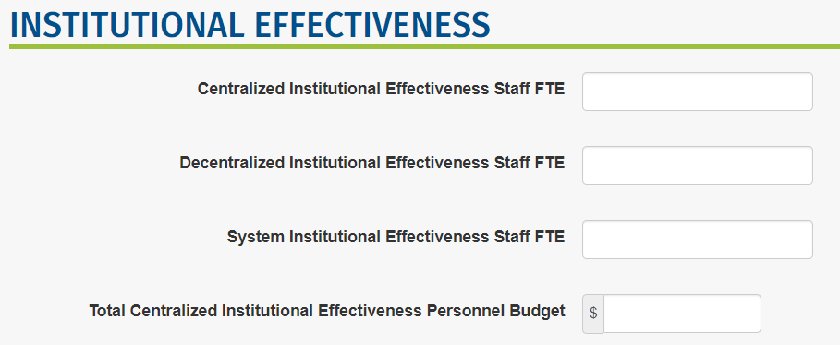
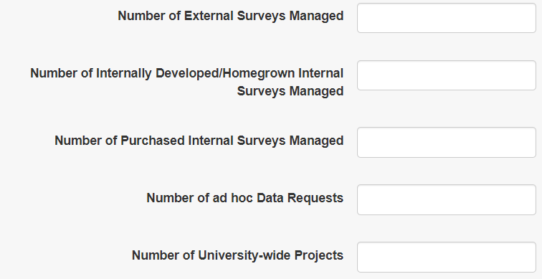
Data Entry Example
Data collection
Web data entry
Data verification: logical errors, outlier checks
Voluntary project: colleges provide only available data
Confidentiality assured

Slide 5
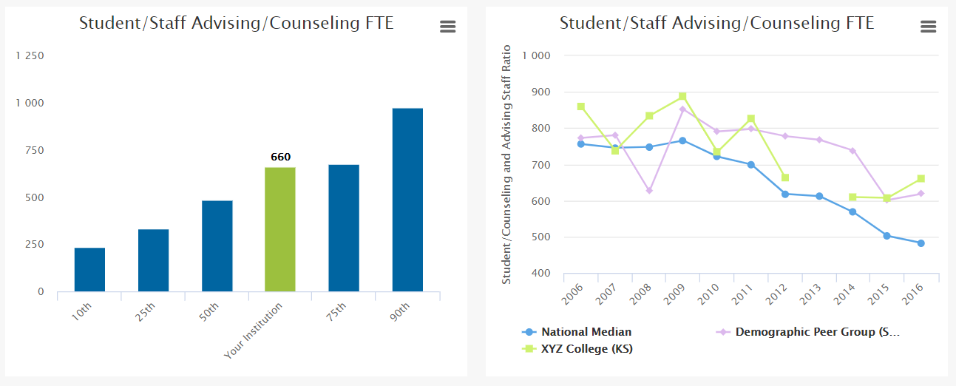
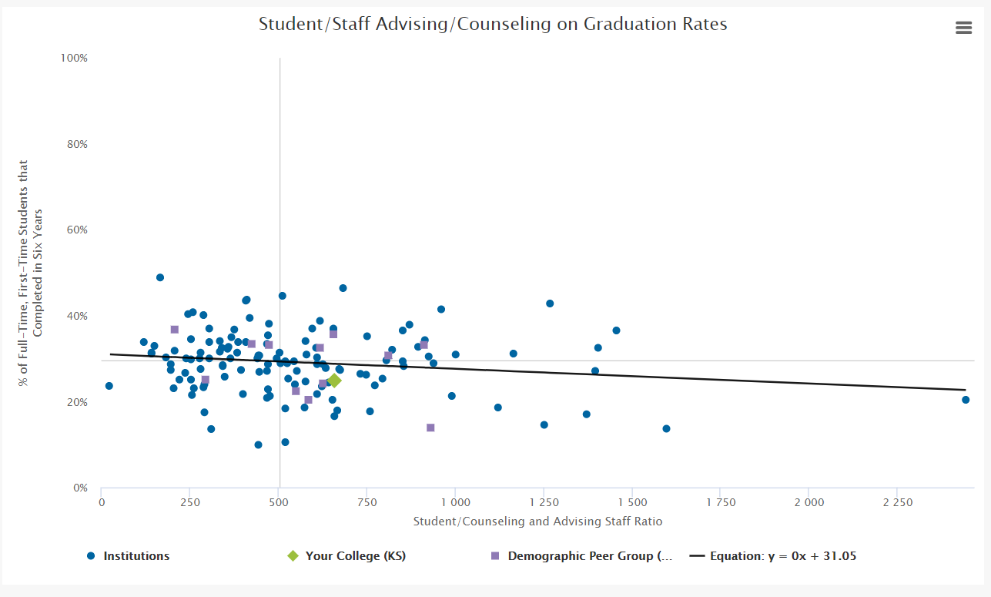
Reports
National Data/Reports
Peer Reports
Best Performers Report
Custom Reports
Trends
Scatter Plots
Bubble Charts

